Slide 1
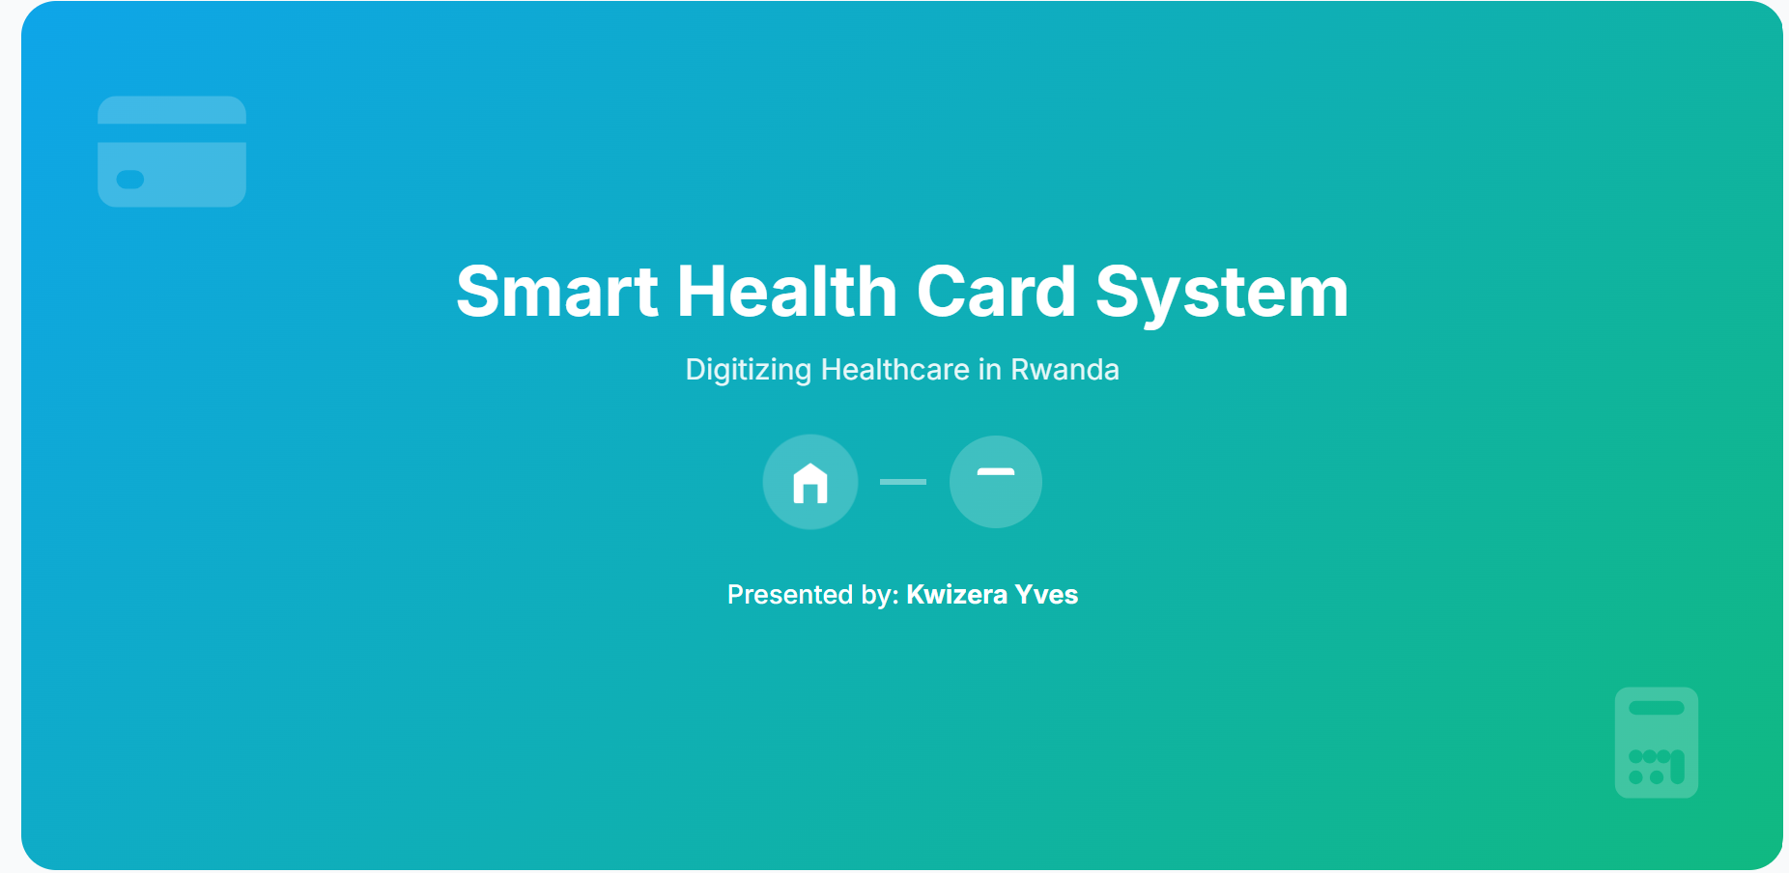


Slide 2
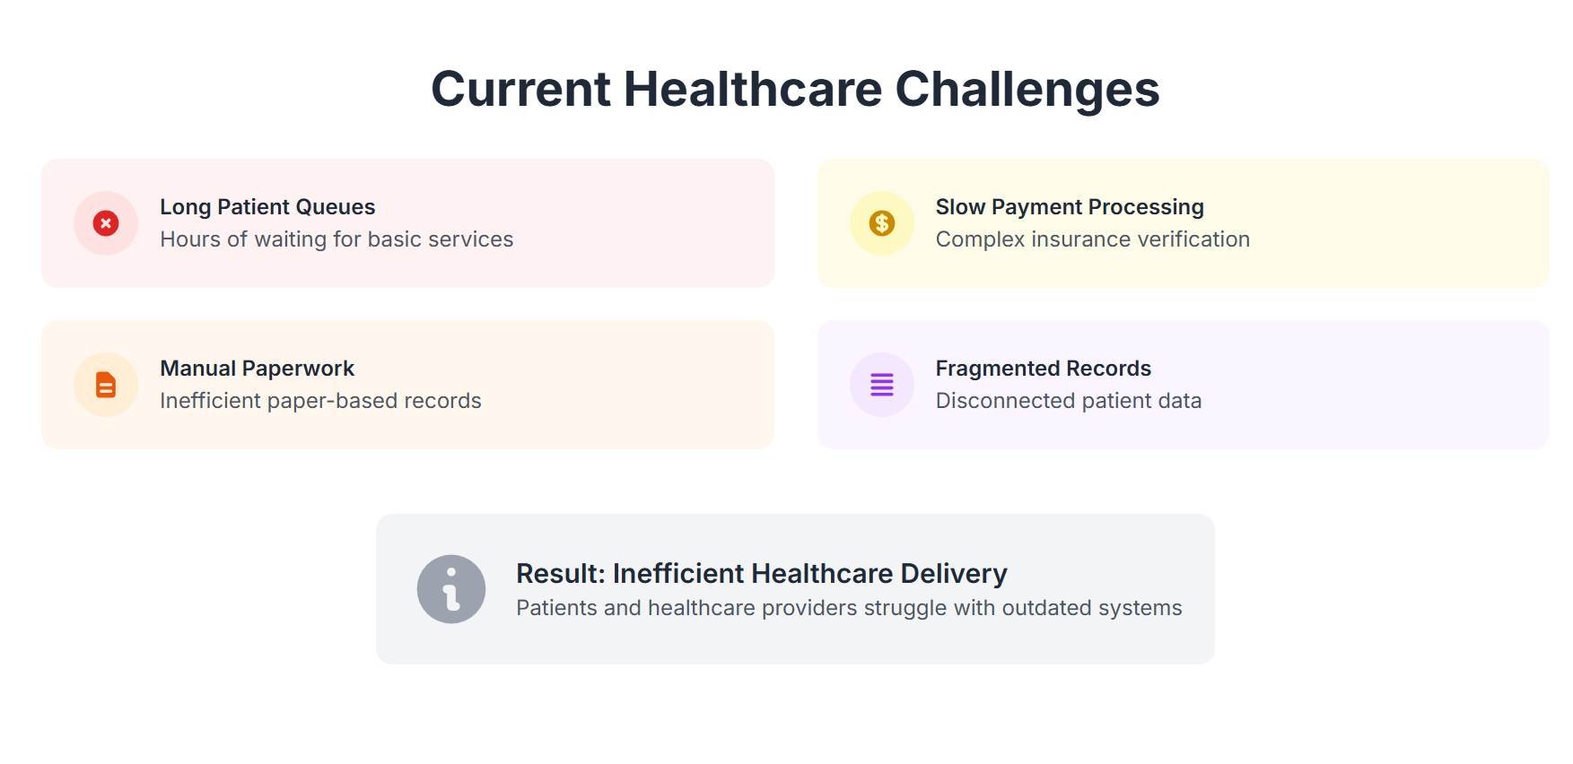

Slide 3
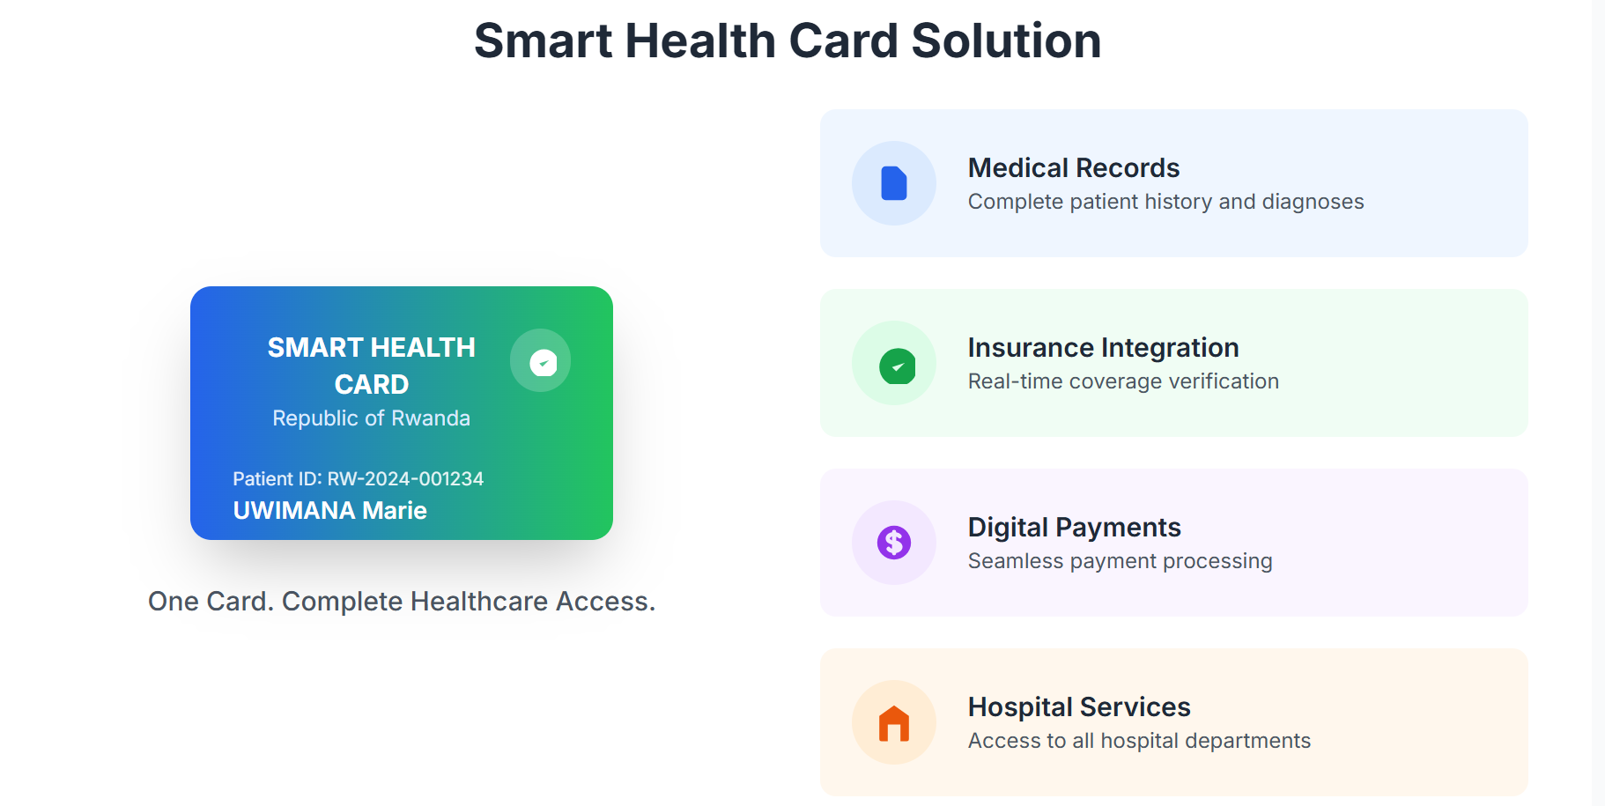

Slide 4
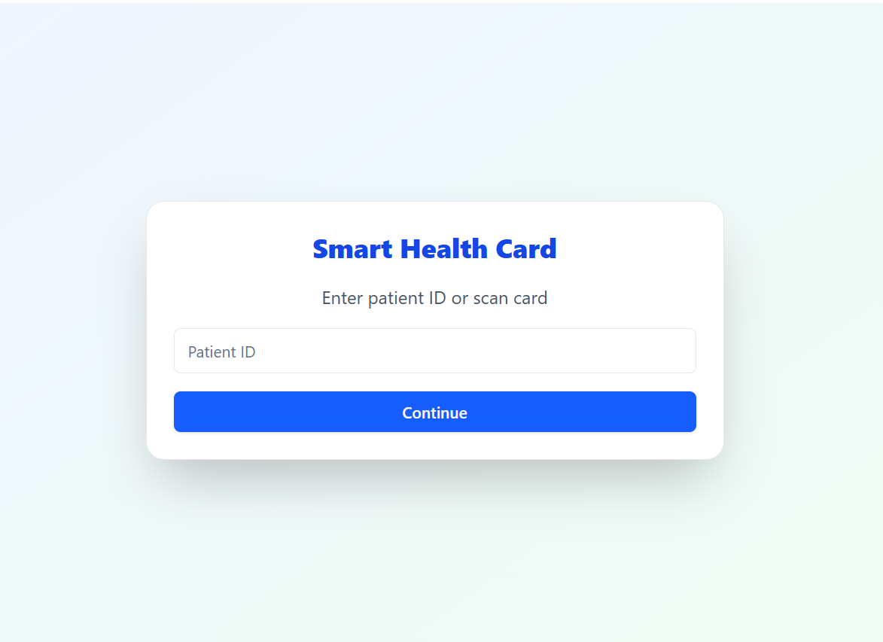
System Interface Overview

Slide 5
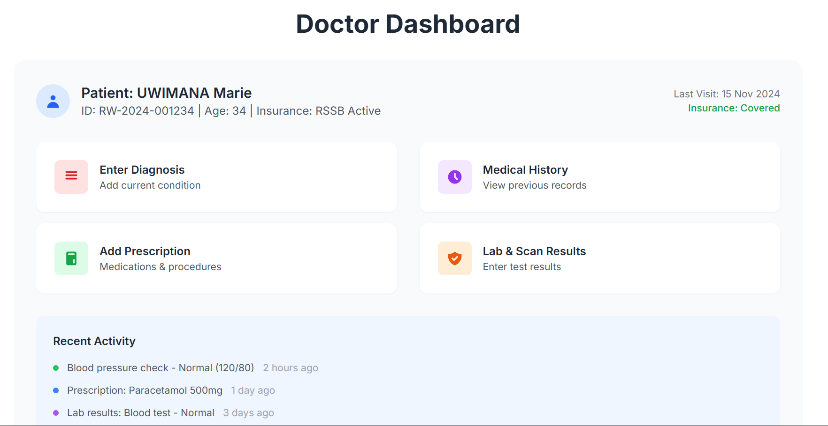

Slide 6
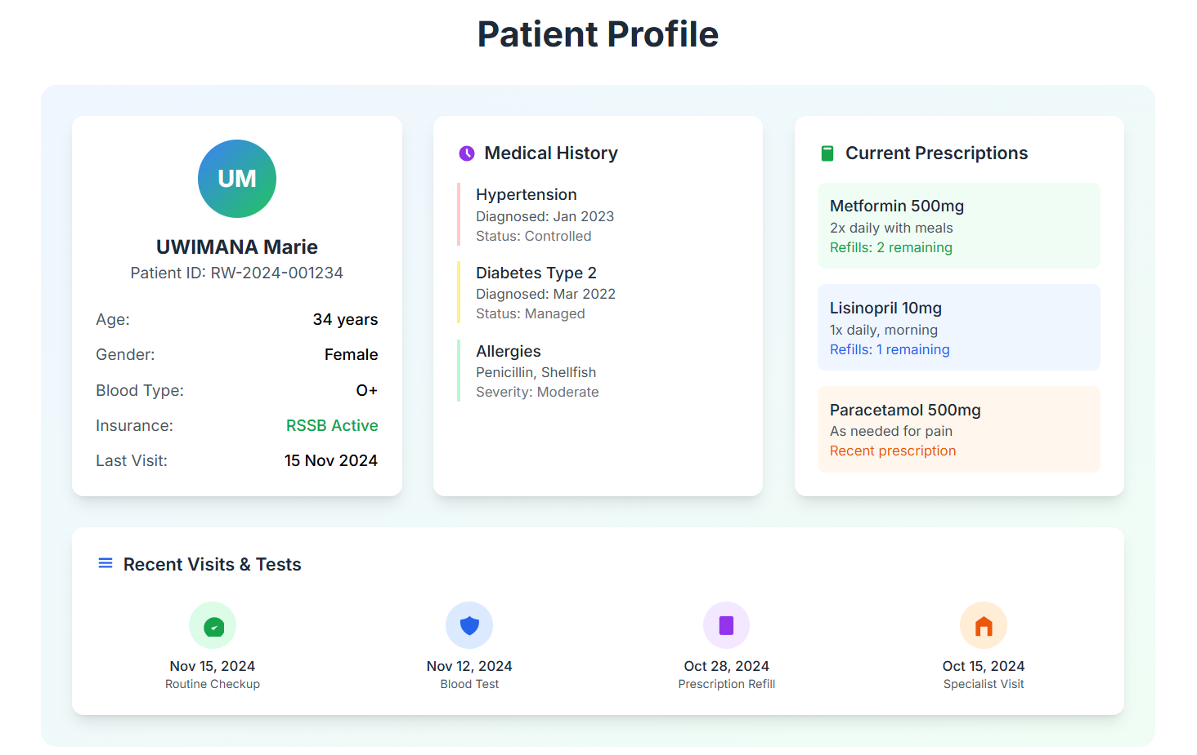

Slide 7
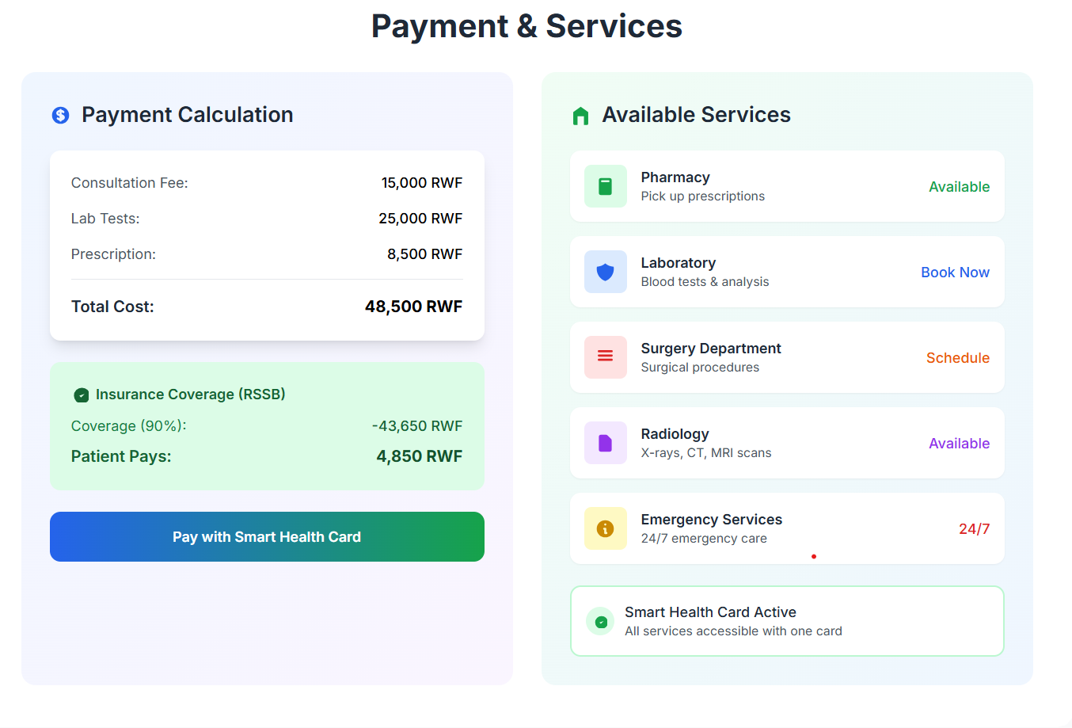

Slide 8
Transforming Rwanda's Healthcare Future
The Smart Health Card System is not just a technological upgrade; it's a foundational shift towards a more efficient, equitable, and patient-centric healthcare future for Rwanda.
1
2
3
4
Pilot Program
Expansion
Nationwide Integration
Smart Health 2025
Successful implementation in key public hospitals.
Phased rollout to private clinics and regional health centers.
Seamless data sharing across all healthcare providers.
Achieving the national vision for digital healthcare excellence.
Transforming Rwanda's healthcare, one card at a time.

